Slide 1
Data Exploration and Transformation in Azure Databricks

Slide 2

Describe Azure Databricks and DataFrames
Use Azure Databricks to read and write data
Identify advanced DataFrame methods in Azure Databricks
Explore Databricks File System

Slide 3
Introduction to Azure Databricks

Slide 4



Business Scenario
Problem Statement:
You are a senior data analyst who has performed various operations using serverless SQL pool. Now, you will learn about Azure Databricks.
Objectives:
Understand the concepts of Azure Databricks to explore and manipulate data.

Slide 5

Databricks
Databricks eliminate complexity and provide convenience to set up a spark cluster.
Databricks provides an analytics platform that is powered by Apache Spark.
Notes:
Trainer notes :
The Spark experience is seamless and requires no management, credits to the integration with major cloud providers which includes Microsoft Azure and Amazon Web Services.
You can get a fully-managed cluster up and running in just five minutes in Microsoft Azure’s environment. Also, if you are familiar with Jupyter notebooks or Zeppelin notebooks, you will easily catch up with Databricks notebooks, as it is the central part to work on. Scala and Python, both are supported and even the combination of them is supported.

Slide 6
Features of Databricks
Databricks enhances data collaboration and integration with the following features.
Open
2
Simple
3
Collaborative
1
Notes:
•Simple: It is used to reduce the number of moving parts in your infrastructure. On one cloud or numerous clouds, move data less and enable greater governance.
•Open: With databricks, you can quickly adapt to new advancements while maintaining control over your data.
•Collaborative: With databricks, your teams will be able to collaborate throughout the whole data and AI pipeline thanks to intuitive collaborative tools and wide integrations.

Slide 7
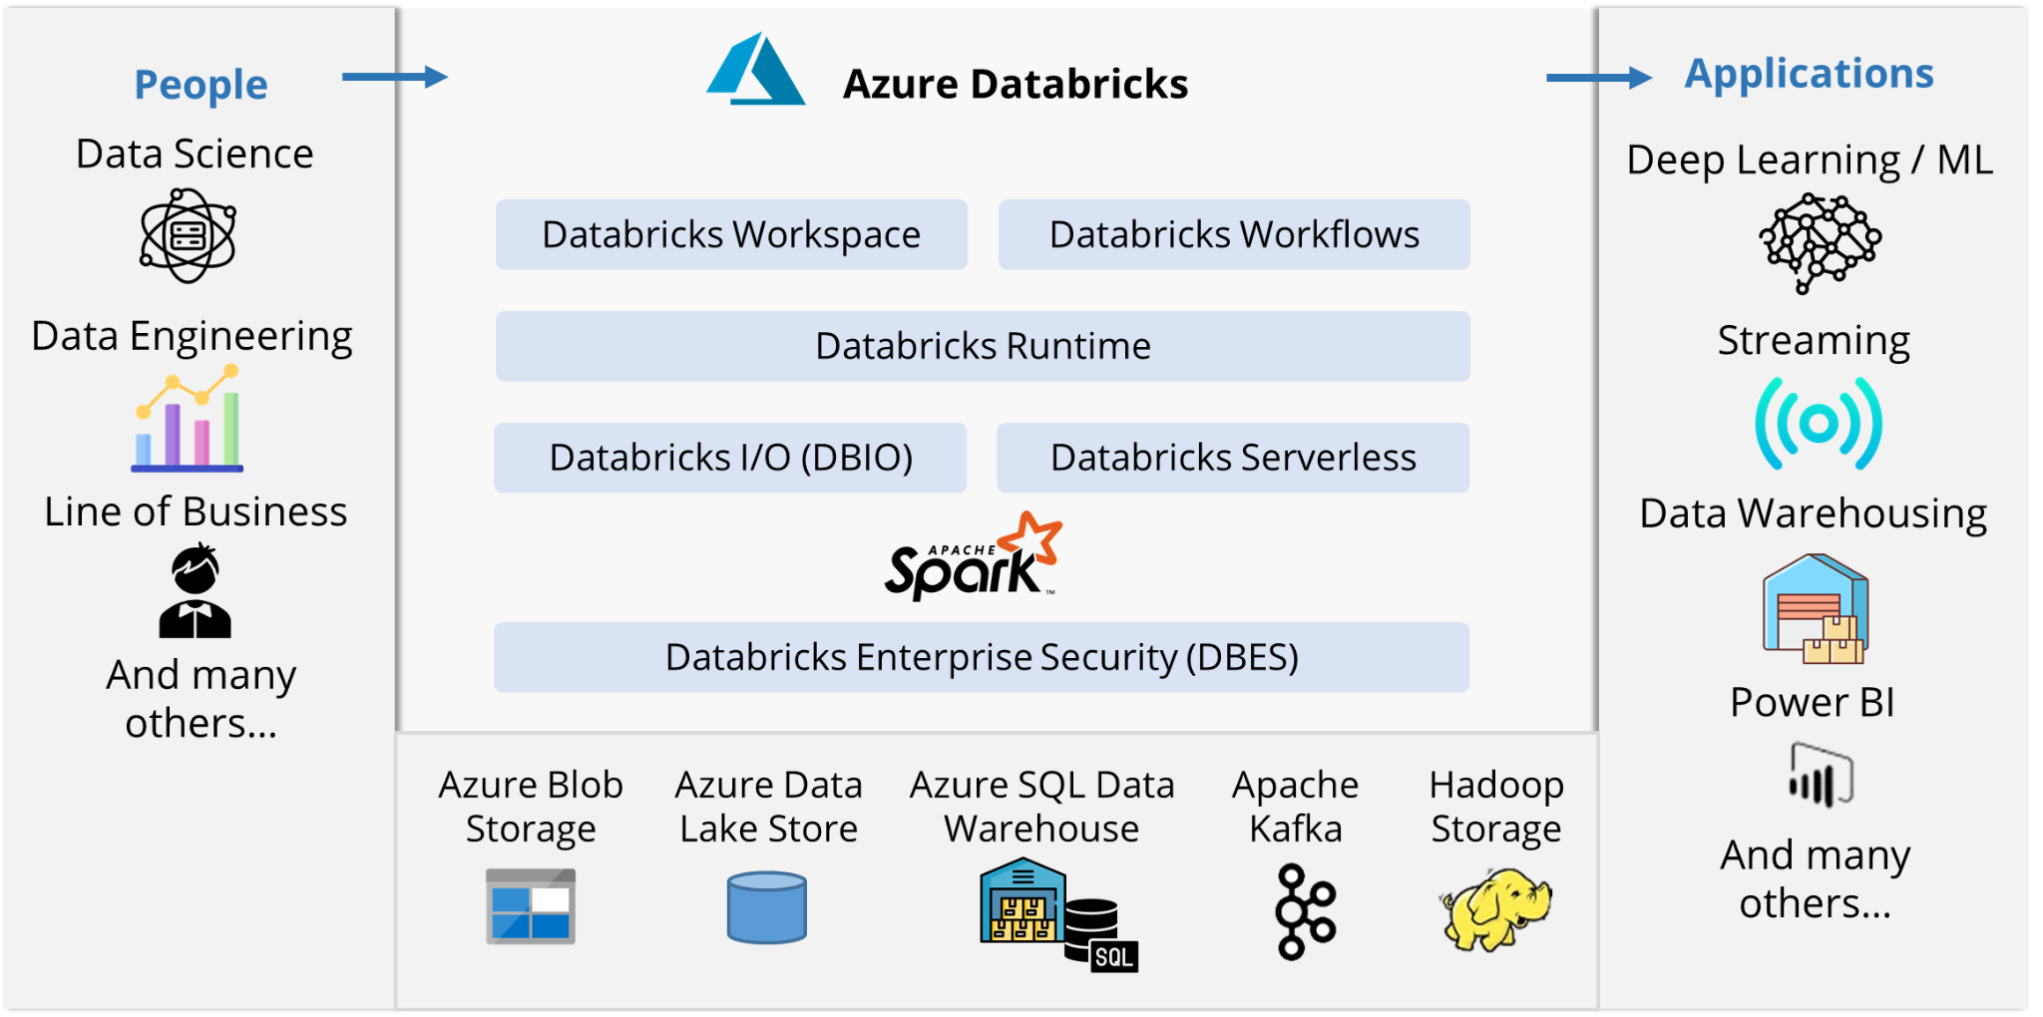
Databricks in Data Science and Engineering
It is an Apache Spark-based analytics platform that provides a one-click setup, faster processes, and an interactive workspace for data engineers and data scientists to collaborate.
Source: https://s33046.pcdn.co/wp-content/uploads/2020/03/azure-databricks-integration-with-other-services-.png
Notes:
The data is imported into Azure in batches using Azure Data Factory or streamed in near real-time using Apache Kafka, Event Hub, or IoT Hub for a big data pipeline. Use Azure Databricks to read data from a variety of sources, including Azure Blob Storage, Azure Data Lake Storage, Azure Cosmos DB, and Azure SQL Data Warehouse, and convert it into new insights using Spark as part of your analytics process.

Slide 8
Reading and Writing Data in Azure Databricks

Slide 9
Business Scenario
Problem Statement:
You are a senior data analyst who knows the concepts of Azure Databricks. Now, you will learn about various operations in Azure Databricks.
Objectives:
Understand the concepts to perform reading and writing data in various file formats using Azure Databricks.

Slide 10
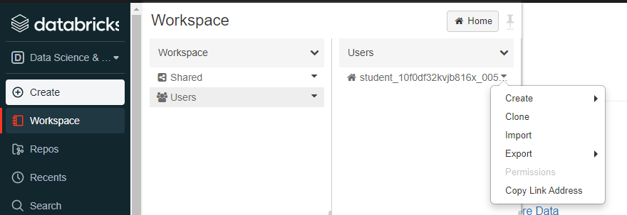
Reading Data in CSV Format
The data in a CSV formatted file can be imported in Azure using the help import option.
Source: https://docs.microsoft.com/en-us/learn/wwl-data-ai/read-write-data-azure-databricks/media/import-archive.png
Notes:
You just need to launch a workspace first and on the top left, there’s a drop-down where you will find an option to import the CSV file directly.

Slide 11
Reading Data in JSON Format
Databricks allows importing JSON-formatted files in single-line or multiline mode.
In single line mode, JSON files can be divided into many parts that can be read simultaneously.
To read JSON data, use:
Example: Single-line mode
val df = spark.read.json("example.json")
Example: Multiline mode
val mdf = spark.read.option("multiline","true").json("/tmp/demo.json") mdf.show(false)

Slide 12
Reading Data in Parquet Format
Parquet file format provides optimizations for querying, and it is more efficient than CSV or JSON.
Example:
data = spark.read.parquet("/tmp/Parquetfile")

Slide 13
Writing Data
Apache Spark is used to write data frame into disk and data into multiple files.
Example:
df.write.format("csv").mode("overwrite").save("/my-file/demo-csv")

Slide 14
Introduction to DataFrames in Azure Databricks

Slide 15
Business Scenario
Problem Statement:
You are a senior data analyst who can read, write, and manipulate data in various file formats using Azure Databricks. Now, you will learn the concepts of DataFrames in Azure Databricks.
Objectives:
Understand the concepts to handle data with various file system permissions and use advanced methods in DataFrames.

Slide 16
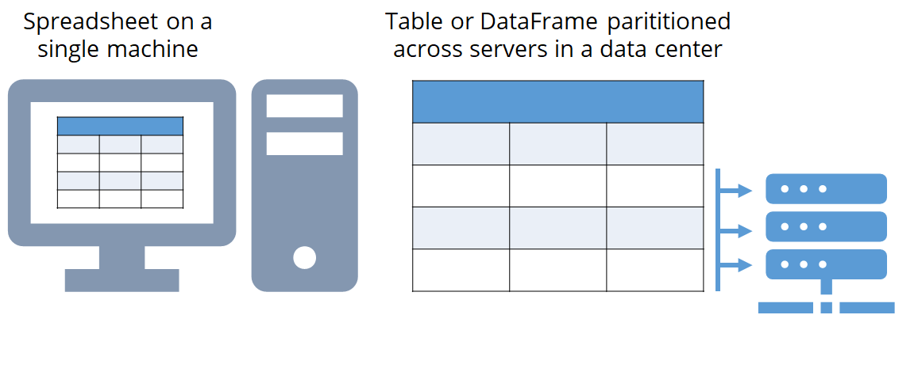
DataFrame
It is a spark Application Programming Interface (API) that facilitates a wide range of functions such as select columns, join, filter, and aggregate, which helps in solving common data analysis problems efficiently.
Notes:
Dataframes can also be used to intermix operations seamlessly with R, Scala, SQL, and Python code.

Slide 17
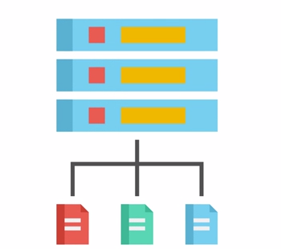
DataFrame in Azure Databricks
DataFrame in Azure Databricks is the common structured application programming interface (API) that represents data in row-column format.
Notes:
A Dataframe in Azure Databricks is different from a spreadsheet in a way that, unlike a normal spreadsheet, DataFrame can be shared across multiple computers.

Slide 18
Advanced DataFrame Methods in Azure Databricks

Slide 19
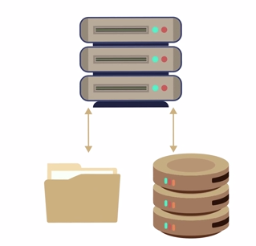
Advanced DataFrame Methods in Azure Databricks
Following are the advanced methods that data engineers can use to read, write, and transform data using DataFrames.
Date and time manipulation
Aggregate functions
Data deduplication
Notes:
Performing date and time manipulation - Includes changing date and time in dataframes
Using Aggregate functions
- Includes functions such as boolean evaluation of an expression, average, bit_and, bit_xor, and so on.
Deduplication of Data
-Data Deduplication is a technique used to save up a lot of space in storage systems, in simple words it keeps two same files as one until and unless any change is made on any one of the files

Slide 20
Introduction to Databricks File System

Slide 21
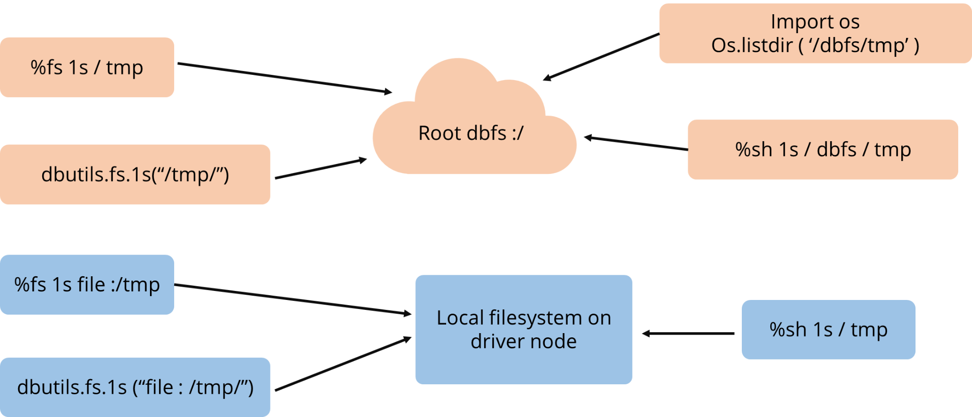
Databricks File System
Databricks file system, also known as DBFS, is a distributed file system.
It has a master-slave architecture to attain reliability.
Notes:
Databricks file system, also known as DBFS, is a distributed file system, that is, it has a master-slave architecture to attain reliability. It is attached to the databricks workspace and is available on databricks clusters as well.

Slide 22
Advantages of Databricks File System
Mount storage objects so that you can access them without credentials.
Read and write in object storage using files and directories instead of URLs.
Find the data persisted in object storage even after cluster termination.
Notes:
Advantages:
Mount storage objects so that you can access them without credentials.
Read and write in object storage using files and directories instead of URLs
Even after termination of the cluster, the data is persisted in object storage

Slide 23
Databricks File System Permissions
The default locations of numerous types of data saved are described in the DBFS root, such as:
/databricks/init:
/databricks-datasets:
/databricks-results:
/FileStore:
/user/hive/warehouse
Notes:
the users have access to read and write objects in the Databricks file system. DBFS root says about default locations of several types of data stored, as:
/databricks/init: Init scripts
/databricks-datasets: Public datasets for sample use
/databricks-results: Files where the output of queries is stored
/FileStore: Contains uploaded files
/user/hive/warehouse: Hive tables metadata and data

Slide 24
Assisted Practice: Using DataFrames in Azure Databricks
Duration: 20 Min.
Problem Statement: You are supposed to explore company data. For that, you decide to use the functions of DataFrames in Azure Databricks to explore and filter the stored data.
.
Note: Please download the solution document from the Course Resources section and follow the steps given in the document.

Slide 25
Assisted Practice: Caching a DataFrame
Duration: 20 Min.
Problem Statement: Caching data is a good method for faster subsequent queries. This will help fetch subsequent data quickly and efficiently. To do so, perform caching of a DataFrame.
Note: Please download the solution document from the Course Resources section and follow the steps given in the document.

Slide 26
Assisted Practice: Removing Duplicate Data
Duration: 10 Min.
Problem Statement: In order to have the right set of data, you are supposed to perform duplicate data removal. Document the step-wise solutions for further reference.
Note: Please download the solution document from the Course Resources section and follow the steps given in the document.

Slide 27
Assisted Practice: Manipulating Date and Time Values
Duration: 10 Min.
Problem Statement: As a part of manipulating data, you are supposed to manipulate the date and time values.
Note: Please download the solution document from the Course Resources section and follow the steps given in the document.

Slide 28
Assisted Practice: Removing and Renaming DataFrame Columns
Duration: 10 Min.
Problem Statement: You are given a task to remove and rename the DataFrame columns in order to have consistency in the stored data.
Note: Please download the solution document from the Course Resources section and follow the steps given in the document.

Slide 29
Assisted Practice: Aggregating Data Stored in a DataFrame
Duration: 10 Min.
Problem Statement: It is important to have all the data in one place. To do so, you are supposed to aggregate the data stored in a data frame.
Note: Please download the solution document from the Course Resources section and follow the steps given in the document.

Slide 30
Databricks has a master-slave architecture to attain reliability.
Databricks allows importing JSON-formatted files in a single line or multiline mode.
DataFrame in Azure Databricks is the common structured Application Programming Interface (API).
Parquet files consist of columns and their format provides optimizations for querying.

Slide 32
Which of the following provides convenience to get a Spark cluster?
1
Azure Databricks
Azure DataFrames
Databricks File System (DFS)
None of the above

Slide 33
Which of the following provides convenience to get a Spark cluster?
1
Azure Databricks
Azure DataFrames
Databricks File System (DFS)
None of the above
A
Databricks eliminate the complexity and provide convenience to get a spark cluster. The Spark experience is seamless and requires no management.

Slide 34
If you want to mount storage objects so that you can access them without credentials, which of the following can be used?
2
Azure Databricks
Azure DataFrames
Databricks File System (DBFS)
None of the above

Slide 35
If you want to mount storage objects so that you can access them without credentials, which of the following can be used?
2
Azure Databricks
Azure DataFrames
Databricks File System (DBFS)
None of the above
C
Databricks File System (DBFS) is used to mount storage objects so that you can access them without credentials.

Slide 36
Which of the following contains uploaded files?
3
/databricks/init
/databricks-datasets
/databricks-results
/FileStore

Slide 37
Which of the following contains uploaded files?
3
/databricks/init
/databricks-datasets
/databricks-results
/FileStore
D
/FileStore contains all the uploaded files.

Slide 38
Lesson-End Project: Review Course Data
Problem scenario:
You are a junior data engineer, and one of the senior data engineers has asked you to explore the company’s course data and filter it to fetch meaningful insights. You are also required to optimize data querying, which helps fetch data quickly when a similar query is triggered and helps clean the data by allowing one to remove duplicate values, manipulate values, and perform data aggregation.
Objective:
To easily gather insights regarding the sales of specific courses and fetch the required information quickly
Note: Download CoursesData.csv from the Course Resources section in the LMS to perform the required tasks

Slide 39
Lesson-End Project: Review Course Data
Tasks to be performed:
1. Create a Databricks resource and load the data
2. Create DataFrames in Azure Databricks to explore the data
3. Perform data filtering in the rows that contain data for the course HTML5 and CSS Fundamentals with the help of Azure Databricks
4. Optimize the results by caching a DataFrame to improve the speed of subsequent queries

Slide 40
Lesson-End Project: Review Course Data
Tasks to be performed:
5. Clean up the data by removing the duplicate values
6. Manipulate and aggregate the data to fetch meaningful insights
Note: Please download the solution document from the Course Resources section and follow the steps given in the document

Slide 41
In the next lesson, you will be able to:
Work with Apache Spark
Apply Apache Spark to perform big data engineering
Perform data ingestion with Apache Spark Notebooks
Work with Apache Spark Notebook
Perform data transformation with DataFrames in Apache Spark pools
Perform integration of SQL and Apache Spark pools in Azure Synapse Analytics

